Slide 1
Young Playwrights
Festival
2024 Teacher Resource Guide

Slide 2
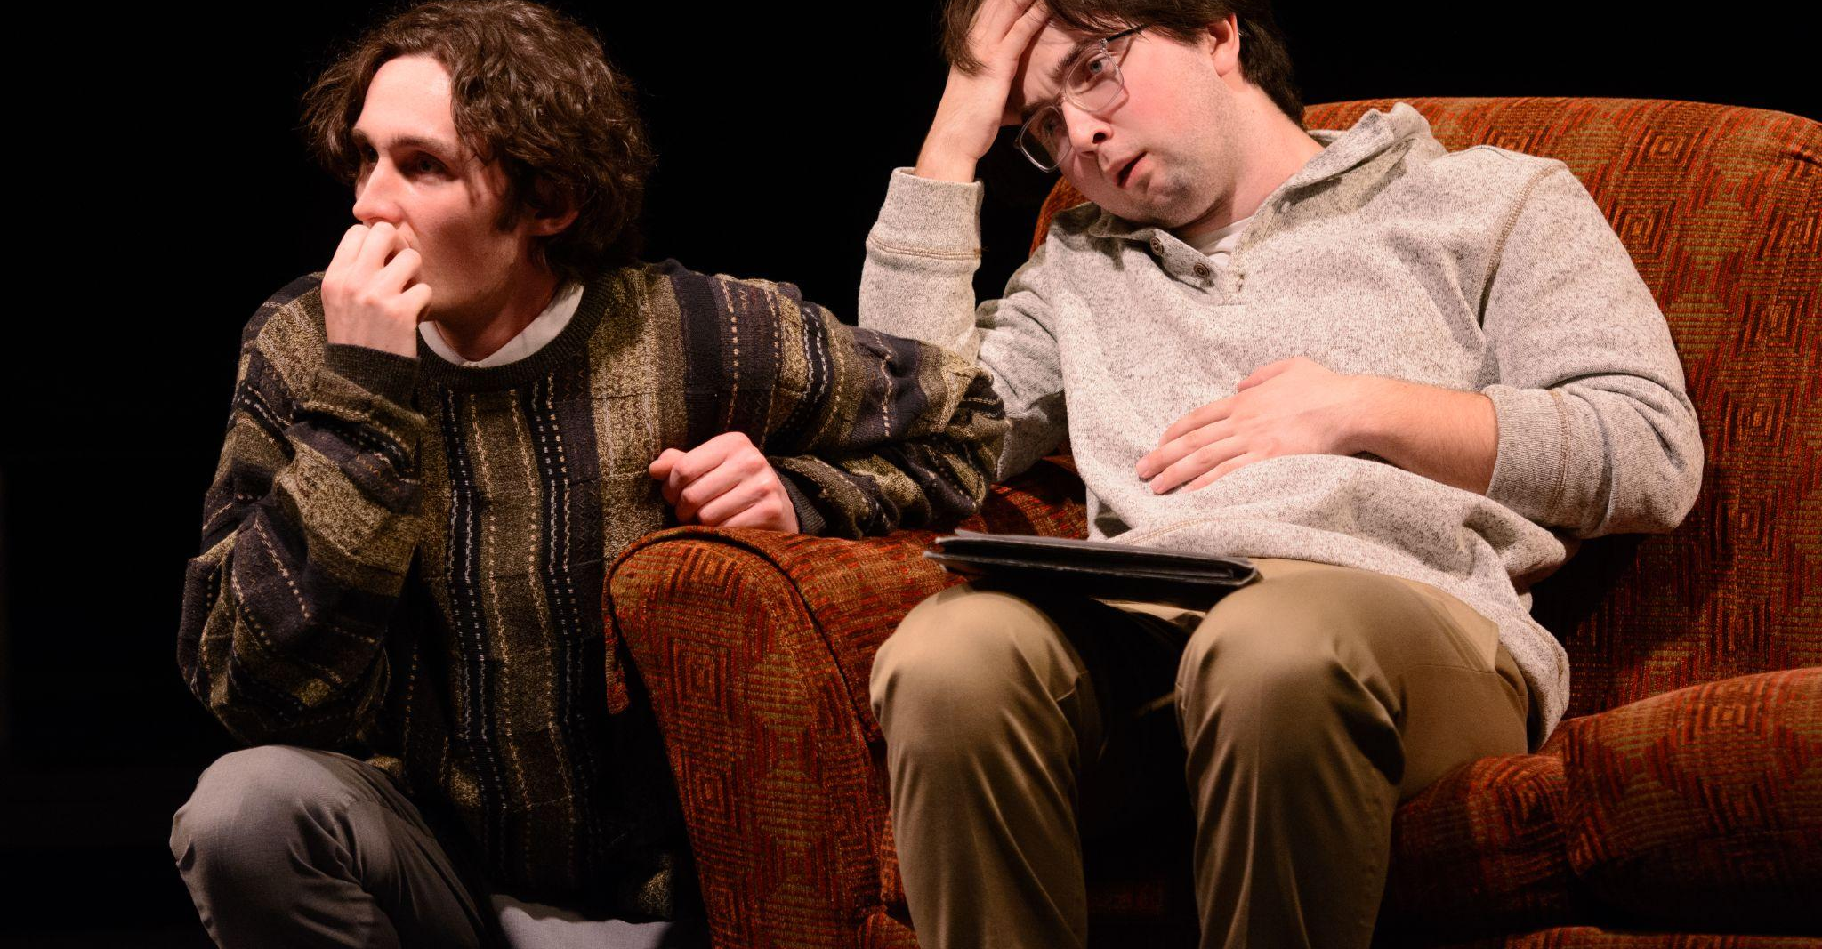
In this presentation you will find exercises, tips, and pointers to help your students write plays for submission to Wharton Center and Michigan State University Department of Theatre’s Young Playwright Festival.

Slide 3
The play’s message
Message
Conflict
Style or Genre
Character
Dialogue

Slide 4
When writing a play, focus on:
Could also be called:
The moral
The message
The premise
The main argument

Slide 5
The play’s MESSAGE (could also be called)
The moral
The lesson
The premise
The main argument
Basically, it is the takeaway you want to leave the audience with.

Slide 6





But how do you know what you want to say?
You have a chance when writing a play:
To tell people something you really care about
Or something makes you laugh
Or your unique vision of the world
Or something that you learned and think others should know

Slide 7
Exercise #1
Message
Mini-Lesson Plan: Identifying the Message for Writing a Play​
Grade Level: High School​
Subject: Theater Arts / Creative Writing​
Duration: 15 minutes​
Objective:​
Students will be able to identify and articulate a clear message or theme for a play they want to write.​
1. Quick Introduction (3 minutes)​
Purpose: Define what a message or theme in a play is.​
Ask the class: “What’s one message or idea a movie or play you’ve seen was trying to communicate?”​
Jot down responses on the board, focusing on the themes (e.g., love, courage, justice).​
Provide a quick explanation that the message of a play is the central idea the playwright wants to communicate, like how The Hunger Games explores survival, inequality, and the power of resistance.

Slide 8
Message
2. Fast Brainstorming Session (5 minutes)​
Purpose: Help students quickly identify a potential message for their own play.​
Ask students to think about something they care about or a problem in the world that frustrates them.​
Prompt with questions like:​
What makes you angry?​
What would you want to change in the world?​
Is there a personal story you want to tell?​
Give them 2-3 minutes to write down ideas in their journals.​
3. Pair Sharing and Refining (5 minutes)​
Purpose: Help students refine their message.​
Have students turn to a partner and share their idea.​
Instruct them to help each other clarify the message by turning it into a single statement.​
Example 1:​ “I care about environmental issues” becomes “My play will show how small actions can have a big impact on saving the environment.”​
Example 2: ​“I’m frustrated by how technology controls our lives” becomes “My play will show how ridiculous people can be when tied to their technology and miss important things."​
4. Quick Wrap-Up (2 minutes)​

Slide 9
Message
Purpose: Final reflection.​
Ask for a few volunteers to share their one-sentence message with the class.​
Conclude by emphasizing that a clear message is what drives the story and gives a play focus.​
Assessment​
Formative: Participation in pair sharing and final message statement.​
This lesson encourages students to think critically about important or humorous topics and refine their ideas into a focused message for their play.​

Slide 10
Conflict
If my message is about our dependence on technology, the conflict could be about a broken Wifi connection.
If my message is about the small ways we can impact climate change, the conflict could be about the changes that can happen at this school that aren’t being done currently.

Slide 11
10-Minute Exercise: Expanding the Message to Create Conflict
Purpose: This exercise helps students take their message and use it to create conflict, a key element that drives action in a play. By developing a scene that reflects their message through conflict, students will deepen their understanding of how to translate themes into dramatic tension.​
1. Set-Up (2 minutes)​
Instruction:​
Ask students to look at the one-sentence message they previously created for their play.​
Explain that in this exercise, they will develop a brief conflict scene based on this message. Conflict is what makes a scene interesting and brings the message to life.​
Example Setup:​
If their message is serious (“Small actions can have a big impact on saving the environment”), their conflict could involve two characters arguing about whether recycling is really important.​
If their message is humorous (“It’s ridiculous how people freak out over broken Wi-Fi”), their conflict could involve a character panicking over the loss of internet access, while another character remains calm.​
2. Quick Conflict Creation (5 minutes)​
Instruction:​
Have students write a short dialogue or outline a scenario where two characters express different views or attitudes about the message they’ve chosen.​
Encourage them to focus on tension between the characters, whether it’s serious or funny.​
Prompt with questions:​
What do the characters want?​
Why do they disagree?​
What does one character believe that the other opposes?​

Slide 12
3. Pair Sharing (3 minutes)​
Instruction:​
Have students pair up and share their conflict scenario with a partner.​
Ask them to give each other quick feedback:​
Is the conflict clear?​
Does it connect with the message?​
4. Reflection (1 minute)​
Instruction:​
Ask a few volunteers to share their conflict scenes with the class.​
Conclude by emphasizing that conflict is what drives the story forward and expresses the message in a way that engages the audience.​
Assessment​
Formative: Participation in writing the conflict scene and in pair sharing.​
This short exercise helps students bridge the gap between having a clear message and developing dramatic tension around it. Through conflict, their message will come alive in a scene.​

Slide 13
Style or Genre?
What is the best way to tell your story?
Comedy?
Drama?
Western?
Musical?
Science Fiction?

Slide 14
10-Minute Lesson: Writing a Play in Different Styles or Genres​
Grade Level: High School​
Subject: Theater Arts / Creative Writing​
Duration: 10 minutes​
Objective:​
Students will explore different genres and styles in playwriting and learn how to adapt a scene or idea to different genres, ​such as comedy, tragedy, or mystery.​
​
1. Quick Introduction to Genres (2 minutes)​
Purpose: Introduce students to various genres in theater.​
On the board, write down a few key genres: Comedy, Tragedy, Mystery, Fantasy, and Drama.​
Briefly define each:​
Comedy: Light, humorous tone, often with a happy ending.​
Tragedy: Serious themes, often with a downfall of the protagonist.​
Mystery: Involves solving a problem or uncovering secrets.​
Fantasy: Elements of magic, otherworldly settings, or impossible events.​
Drama: Focused on realistic characters and emotional depth.

Slide 15
2. Example and Discussion (3 minutes)​
Purpose: Show how a single idea or scene can be adapted to different genres.​
​ Provide a simple scene setup:​
Two friends are arguing because one of them forgot an important event.​
Ask the class:​
How would this argument look in a comedy?​
Example: The argument turns ridiculous, with exaggerated reasons for forgetting, and ends in a silly reconciliation.​
How would it look in a tragedy?​
Example: The forgotten event leads to serious consequences, like the end of a friendship or personal downfall.​
How would it look in a mystery?​
Example: The argument reveals hidden clues about why the event was forgotten, leading to a larger mystery.​
3. Writing Activity (3 minutes)​
Purpose: Students write a short scene in a chosen genre.​
Instruct students to choose one genre (Comedy, Tragedy, Mystery, Fantasy, Drama) and write a quick scene based on the “forgotten event” scenario.​
They should focus on adapting the tone, dialogue, and style to fit their chosen genre.​
4. Pair Sharing (2 minutes)​
Purpose: Students share their work and see how others approached the same idea in different ways.​
Have students quickly share their genre-based scene with a partner.​
Ask them to notice how their partner’s scene differs from theirs based on the genre.​
​

Slide 16




Character
Who would be best to speak about your message?
Who would offer the most conflict?
Who makes sense in your style?
The answer will be the character your create!

Slide 17
Character
So, you have already decided what you want to say, the main conflict, and the style of your show …​
… the next natural decision is who would be the best people to bring your story to life.

Slide 18
Example:​
In the earlier example about the message that we rely too heavily on technology, we know the conflict is a broken WiFi connection and we want it to be a comedy. ​
So, my characters might be:​
A: A very tense and uptight unemployed worker preparing for a really important virtual job interview. ​
B: A really mellow Wi Fi repairman who thinks life is about taking it easy and is in no hurry to complete the job.

Slide 19
Example:​
If the message is the small ways we can combat climate change, the conflict is two people arguing about recycling, and the genre is drama, my characters might be:
A: A high school student who is really worried about the future.​
B: A principal who thinks recycling is too expensive for the school. ​

Slide 20
5-Minute Lesson: Creating Characters from Style, Conflict, and Message​
Grade Level: High School​
Subject: Theater Arts / Creative Writing​
Duration: 5 minutes​
Objective:​
Students will learn how to create dynamic characters by connecting the play's style, conflict, and message.​
1. Quick Introduction (1 minute)​
Purpose: Show how a character is shaped by the play's style, conflict, and message.​
Write three words on the board: Style, Conflict, Message.​
Explain:​
Style: Determines how a character behaves and speaks (e.g., in a comedy, a character may be exaggerated or quirky).​
Conflict: Shapes what the character wants and how they react to obstacles.​
Message: Influences the character's beliefs, values, or transformation throughout the play.

Slide 21
2. Example (1 minute)​
Purpose: Illustrate how these elements combine to create a character.​
Scenario: A character is upset because their friend forgot an important event.​
Comedy: The character is overdramatic, making a huge fuss over something small. Conflict is lighthearted.​
Tragedy: The character feels deeply betrayed, questioning the entire friendship. Conflict is serious.​
Message: The message could be about forgiveness in a comedy or about trust and loyalty in a tragedy.​
3. Quick Writing Activity (2 minutes)​
Purpose: Students create a character using these three elements.​
Ask students to write a quick description of a character using Style, Conflict, and Message.​
Prompt:​
  Choose a style (Comedy, Drama, etc.).​
  Identify the conflict (What does your character want? What’s stopping them?).​
  Connect it to a message (What does your character learn or represent?).​

Slide 22
4. Share and Reflect (1 minute)​
Purpose: Reinforce how combining style, conflict, and message shapes characters.​
Ask a few students to quickly share their character.​
Conclude by highlighting that great characters are created by understanding how style, conflict, and message work together to define who they are and what they represent.​
Assessment​
Formative: Participation in the quick writing activity and sharing.​
This quick lesson helps students understand how to build meaningful, dynamic characters by combining the play’s style, central conflict, and underlying message.​

Slide 23
Dialogue
Plays rely on dialogue or spoken language to tell their stories.
Not everyone talks like you.
Let the dialogue match the character and their imagined life to guide how your characters should speak.

Slide 24
5-Minute Interactive Game: Writing Dialogue for Different Types of Characters​
Grade Level: High School​
Subject: Theater Arts / Creative Writing​
Duration: 5 minutes​
Objective:​ Students will quickly create character-specific dialogue by thinking on their feet and adapting to different personality types.​
1. Character Type Assignment (1 minute)​
Purpose: Assign character types to students to guide the dialogue.​
Write or assign several character types on the board (or hand out slips of paper with the character types). Examples could be:​
Grumpy Old Person​
Overly Polite Waiter​
Overconfident Superhero​
2. Scenario Setup (1 minute)​
Purpose: Set a fun, simple scene where the dialogue will take place.​
Provide a basic scenario where all these characters are interacting.​
Example: “You’re all waiting in line for a concert, but it’s been delayed.”​
OR: “You’re all on a stuck elevator, and no one knows when it will move.”​
Sarcastic Teenager​
Worried Parent​
Clueless Tourist​

Slide 25
3. Dialogue Game (2-3 minutes)​
Purpose: Students improvise dialogue based on their character type.​
Instructions:​
Each student must write or say one line of dialogue based on their assigned character type.​
Their line should reflect the personality of their character.​
Example:​
    Grumpy Old Person: "In my day, we didn’t stand around waiting for these things. This is ridiculous!”​
    Overly Polite Waiter: "I do apologize for the delay, everyone. May I offer you some imaginary refreshments while we wait?"​
    Overconfident Superhero: "Don’t worry! I’ll get us out of here in no time—just need my cape."​
    Sarcastic Teenager: "Wow, this is, like, exactly how I wanted to spend my Saturday. Totally not a waste of time."​
    Worried Parent: "What if we’re stuck here forever? I knew I should’ve brought extra snacks!"​
    Clueless Tourist: "Oh, I thought this was part of the tour. How exciting!"​
Interactive Version:​
Have students stand up and take turns saying their dialogue out loud, or do it quickly popcorn-style where they jump in as their character.

Slide 26
4. Quick Reflection (1 minute)​
Purpose: Highlight how different characters shape dialogue.​
Ask a few students how their character’s personality changed the way they spoke.​
Conclude by emphasizing that writing dialogue involves adapting the way characters talk to their unique personalities and perspectives.​
Assessment​
Formative: Participation in the dialogue game.​
This interactive and fast-paced game encourages students to think on their feet, adapting dialogue to fit different character types and personalities!

Slide 27
Young Playwrights Festival
Using the elements of message, conflict, style, characters, and dialogue, your students can begin writing a play.

Slide 28
If you have any questions about the Young Playwrights Festival or would like to request a workshop, please contact Kelly Stuible-Clark at stuible3@whartoncenter.com.

